Slide 1
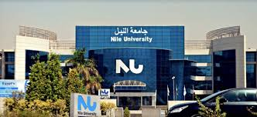
جــــامـــعــة النيل Nile UNIVERSITY Quantum Summar School 2025
Quantum Time Series Prediction: An Audio Case Study
Dr. Iman Abdelrahman
Visiting Professor, NU
Day 6
August 11, 2025
بسم الله الرحمن الرحيم

Slide 2
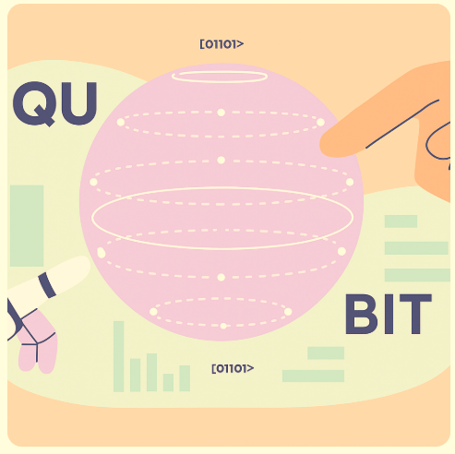
Contents
Classical Machine Learning
Quantum Machine Learning (QML)
Quantum Data Encoding
Example: Representation of a time series signal (Audio) on A Quantum Computer
Machine learning Methods (QNN)

Slide 3
(1/5)- Classical Machine Learning
Machine Learning (ML) is a branch of artificial intelligence (AI) that focuses on creating algorithms and models that allow computers to learn patterns from data and improve their performance on tasks without being explicitly programmed for every step.

Slide 4

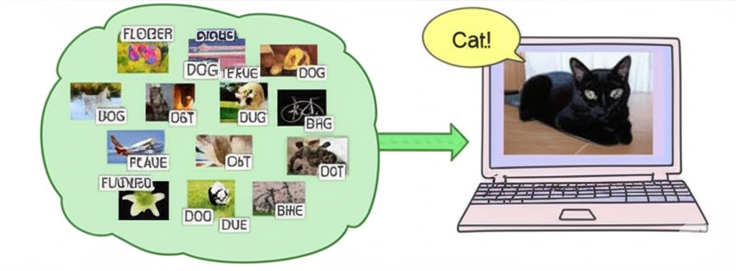
(1/5)- Classical Machine Learning
Well known AI applications
Image Recognition
Speech Recognition
https://universe.roboflow.com/pean1group2/zoo-zmakw
https://www.explainthatstuff.com/voicerecognition .html

Slide 5
(1/5)- Classical Machine Learning
Three Ingredients
Data
Model
Loss
Types of Classical Data
Images,
Audio
Texts,
Graphs,
Medical records,
Stock prices,
Properties of molecules,
Outcomes from biological experiments
Collision traces from high-energy physics experiments.
(Time Series)

Slide 6
(1/5)- Classical Machine Learning
Three Ingredients
Data
Model
Loss
One could define models in machine learning as functions, distributions, algorithms or rules that reproduce the properties of a set of data samples.

Slide 7
(1/5)- Classical Machine Learning
Three Ingredients
Data
Model
Loss
In order to select the best model from a model family, we need a measure of quality
of a model.

Slide 8
Quantum Machine Learning (QML)
QML combines quantum computing principles with classical machine learning algorithms, enabling the tackling of complex real-world problems that are challenging for classical computers
(2/5)- Quatum Machine Learning (QML)

Slide 9
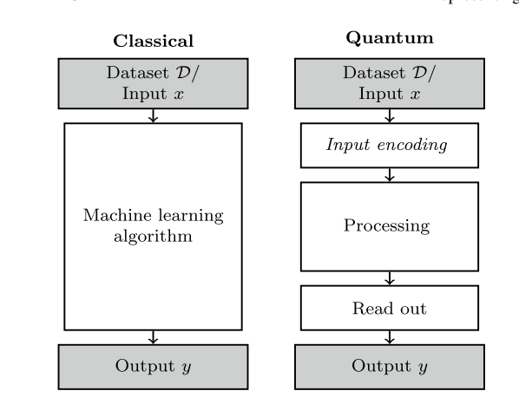
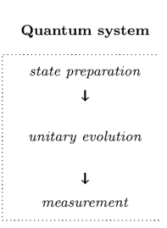
Classical versus Quantum machine learning
Classical Machine Learning
Quantum Machine Learning
(2/5)- Quatum Machine Learning (QML)
M. Schuld and F. Petruccione, Machine Learning with Quantum Computers, 2nd ed. Cham, Switzerland: Springer, 2021

Slide 10
(2/5)- Quatum Machine Learning (QML)
CC: Classical data being processed classically ( or classical algorithm inspired by quantum mechanics)
QC: Quantum data, Classical processing
CQ: Classical data, Quantum processing (Quantum Machine Learning)
QQ: Quantum data, Quantum processing
Data processing device
CC
CQ
Data generating system
QC
QQ
Maria Schuld
Creative Commons Attribution-Share Alike 4.0

Slide 11

Quantum Machine Learning (QML)
Quantum Computer
x
$$\hat{y}$$
(2/5)- Quatum Machine Learning (QML)
Encode
Process
Measure
Data is the fuel of a machine learning algorithm, and usually, it is true that the more data we have, the better the solutions we can find.
M. Schuld and F. Petruccione, Machine Learning with Quantum Computers, 2nd ed. Cham, Switzerland: Springer, 2021

Slide 12
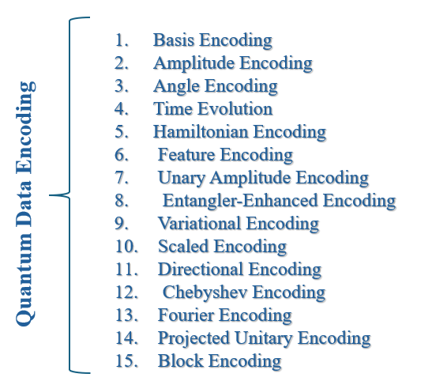
Quantum Encoding Techniques
3/5 Quantum Data Encoding
Ranga et al., “Quantum Machine Learning: Exploring the Role of Data Encoding Techniques, Challenges, and Future Directions,” Nov. 01, 2021).

Slide 13
There are numerous quantum encoding techniques. Selecting the appropriate one requires carefully weighing trade-offs involving:
the number of qubits required,
(ii) the nature of the data itself,
(iii) circuit depth (i.e., the number of quantum gates required in state preparation), and
(iv) the runtime complexity for the loading process.
3/5 Quantum Data Encoding
1. M. A. Khan, M. N. Aman, and B. Sikdar, “Beyond Bits: A Review of Quantum Embedding Techniques for Efficient Information Processing, 2024

Slide 14
Qubit Requirements and Runtime Complexity
Encoding Methods | # Qubits | Runtime
Basis Encoding | N | O(MN)
Amplitude Encoding | Log N | O(MN)/ O(log(MN))
Qsample Encoding | N | O(2 ^{N})/O(N)
Angel Encoding | N | O(N)
QuAM Encoding | 2N+1 | O(MN)
QRAM Encoding | [Log (M)]+l | O(log M)
Superdense Encoding | 2 qubits (entangled pair) per 2 classical bit | O(1)
Hamiltonian Encoding | Log N | O(MN)/O( log(MN)
3/5 Quantum Data Encoding
In the Runtime column: M is the number of inputs or datapoints, N the number of features of each datapoint.
1. M. A. Khan, M. N. Aman, and B. Sikdar, “Beyond Bits: A Review of Quantum Embedding Techniques for Efficient Information Processing, 2024

Slide 15
# | Encoding Methods | Application
1 | Basis Encoding | Arithmetic computations
2 | Amplitude Encoding | Harrow, Hassidim, and Lloyd (HHL) Quantum K-Nearest Neighbor (QKNN) algorithms . Satellite Images
3 | Qsample Encoding | Probabilistic QML models Bayesian Networks. Quantum Boltzmann machines (QBMs)
4 | Angel Encoding | Quantum error handling Quantum image processing (QIMP) Quantum Neural Networks (QNN
5 | QuAM Encoding | Shor’s algorithm Grover’s algorithm Quantum hologrphy
6 | QRAM Encoding | Quntum database research Quantum cryptography Eigenvalues processing in HHL algorithm Telecommunications
7 | Superdense Encoding | Quantum security Quantum communication networks Quantum secure direct communication (QSDC)
8 | Hamiltonian Encoding | Hybrid factoring algorithm Adiabatic quantum computation (ADC) Quantum tomography
3/5 Quantum Data Encoding

Slide 16
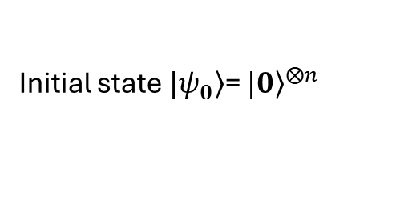
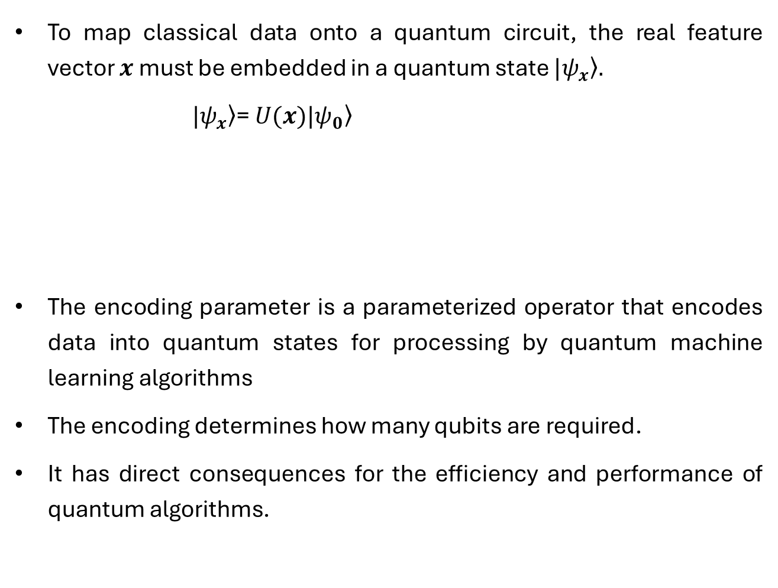
Feature Map (Data Encoding)
To map classical data onto a quantum circuit, the real feature vector $x$ must be embedded in a quantum state $|\left.ψ_{x}\right\rangle .$
$|\left.ψ_{x}\right\rangle$= $U(x)|\left.ψ_{0}\right\rangle$
The encoding parameter is a parameterized operator that encodes data into quantum states for processing by quantum machine learning algorithms
The encoding determines how many qubits are required.
It has direct consequences for the efficiency and performance of quantum algorithms.
Encoded state
Encoding operator
Initial state $|\left.ψ_{0}\right\rangle$= ${|\left.0\right\rangle }^{⨂n}$
Prepared by Dr. Marwa , Nile University

Slide 17
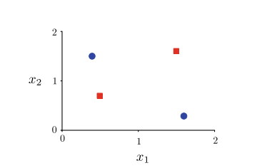
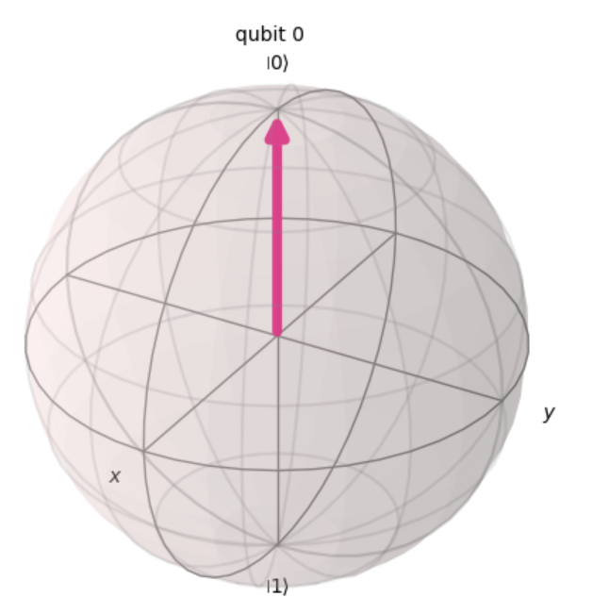
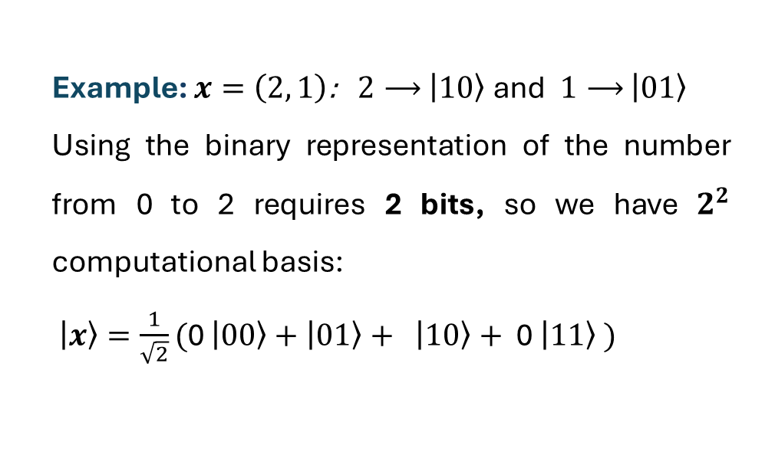
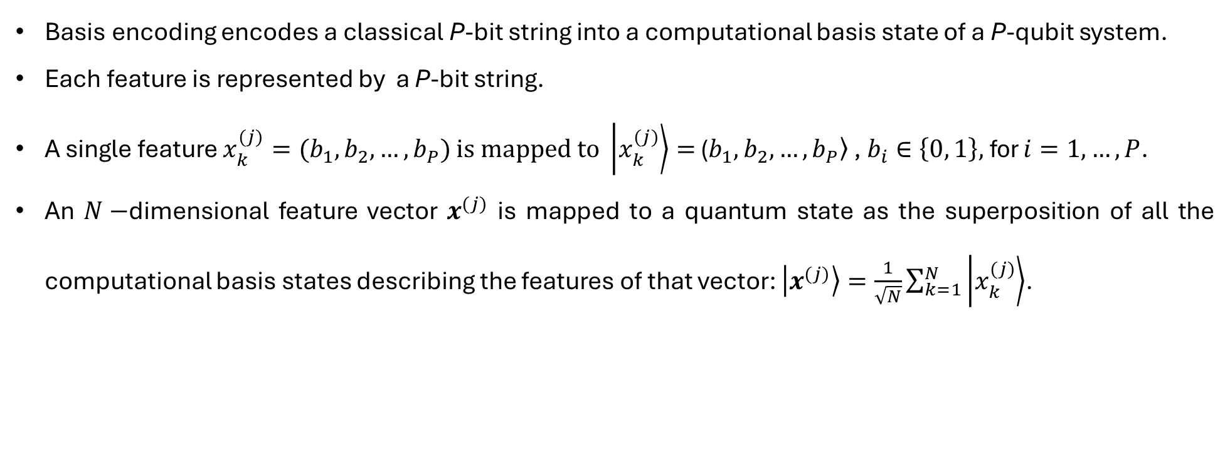
Basis Encoding
Basis encoding encodes a classical P-bit string into a computational basis state of a P-qubit system.
Each feature is represented by a P-bit string.
A single feature $x_{k}^{(j)}=(b_{1}, b_{2}, …, b_{P})$ $is mapped to \left|\left.x_{k}^{(j)}\right\rangle \right.=$ ($\left.b_{1}, b_{2}, …, b_{P}\right\rangle$ , $b_{i}∈\left\{0, 1\right\},$for $i=1, …, P$.
An $N−$dimensional feature vector $x^{(j)}$ is mapped to a quantum state as the superposition of all the computational basis states describing the features of that vector: $\left|\left.x^{(j)}\right\rangle \right.=\frac{1}{\sqrt{N}}\sum_{k=1}^{N}{\left|\left.x_{k}^{(j)}\right\rangle \right.}$.
Example: $x=\left(2, 1\right)$: $2⟶$ $\left|\left.10\right\rangle \right.$and $1⟶$ $\left|\left.01\right\rangle \right.$
Using the binary representation of the number from 0 to 2 requires 2 bits, so we have $2^{2}$ computational basis:
$\left|\left.x\right\rangle \right.=\frac{1}{\sqrt{2}}($0 $\left|\left.00\right\rangle + \right.\left|\left.01\right\rangle + \right.$ $\left|\left.10\right\rangle + \right.$ 0 $\left|\left.11\right\rangle )\right.$
$$⊗$$
Prepared by Dr. Marwa , Nile University

Slide 18
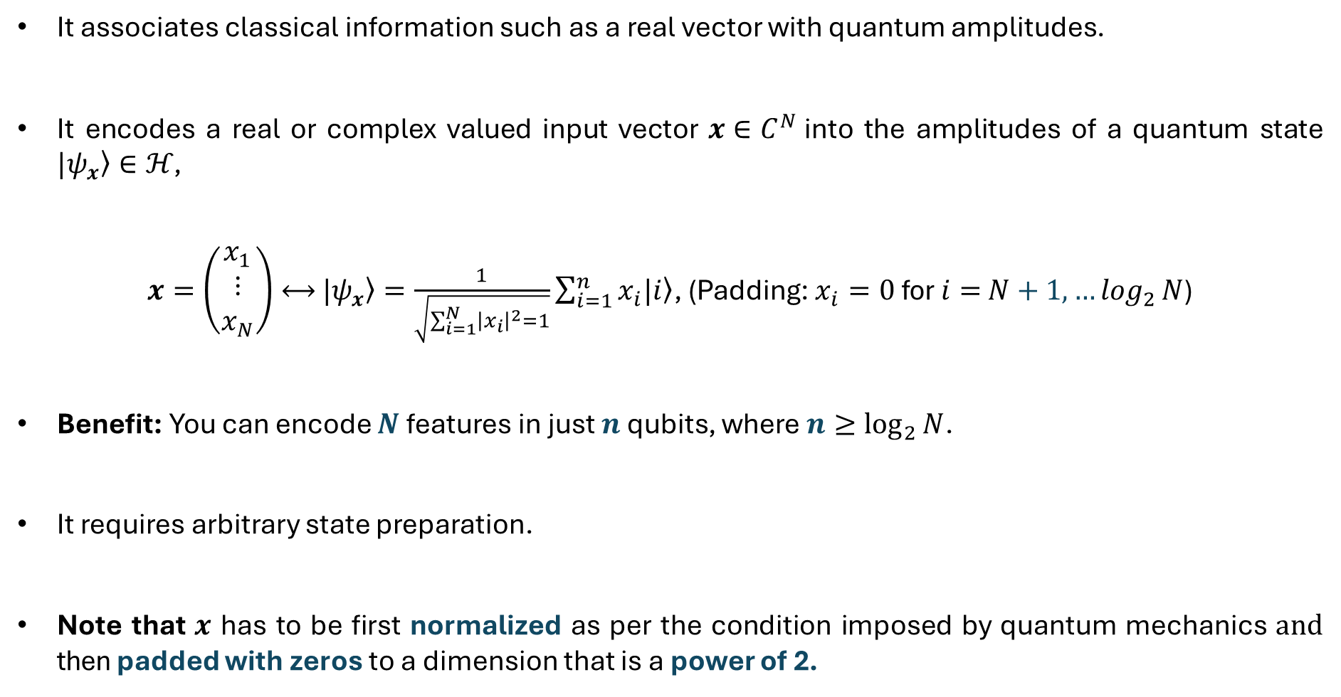
Amplitude Encoding
It associates classical information such as a real vector with quantum amplitudes.
It encodes a real or complex valued input vector $x∈C^{N}$into the amplitudes of a quantum state $|\left.ψ_{x}\right\rangle ∈ℋ$,
$x=\left(\begin{matrix}x_{1} \\ ⋮ \\ x_{N}\end{matrix}\right)⟷$ $|\left.ψ_{x}\right\rangle =\frac{1}{\sqrt{\sum_{i=1}^{N}{{\left|x_{i}\right|}^{2}}=1}}\sum_{i=1}^{n}{x_{i}|\left.i\right\rangle }$, (Padding: $x_{i}=0$for$i=$ ${N+1, …log}_{2}{N}$)
Benefit: You can encode $N$features in just $n$ qubits, where ${n≥log}_{2}{N}$.
It requires arbitrary state preparation.
Note that $x$ has to be first normalized as per the condition imposed by quantum mechanics $and$ then padded with zeros to a dimension that is a power of 2.
Prepared by Dr. Marwa , Nile University

Slide 19
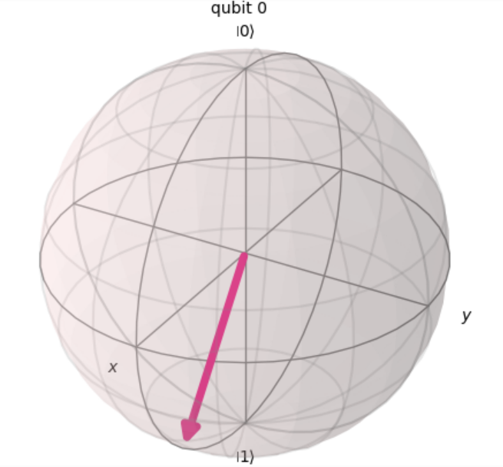
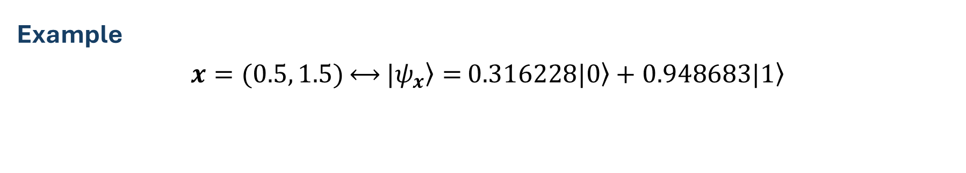
Amplitude Encoding
Example
$x=(0.5, 1.5)$ $⟷$ $|\left.ψ_{x}\right\rangle =$ $0.316228|\left.0\right\rangle +0.948683\left.|1\right\rangle$
.
Prepared by Dr. Marwa , Nile University

Slide 20
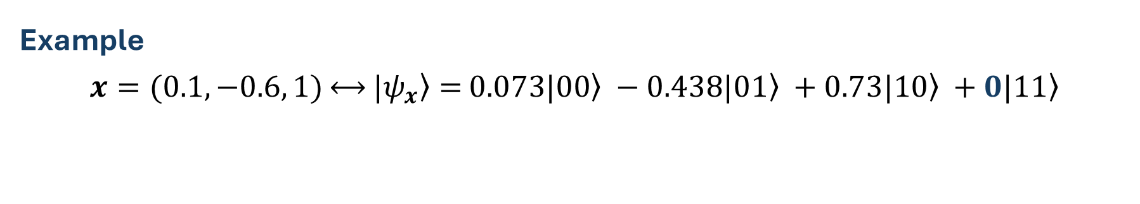
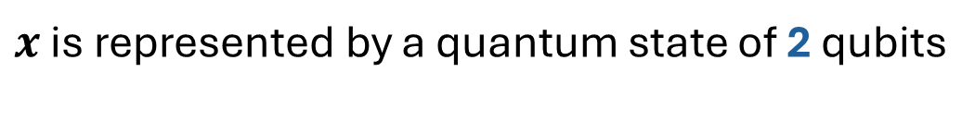
Amplitude Encoding
Example
$x=(0.1, −0.6, 1)$ $⟷$ $|\left.ψ_{x}\right\rangle =$ $0.073|\left.00\right\rangle −0.438|\left.01\right\rangle +0.73|\left.10\right\rangle +0|\left.11\right\rangle$
$x$ is represented by a quantum state of 2 qubits
.
Prepared by Dr. Marwa , Nile University

Slide 21
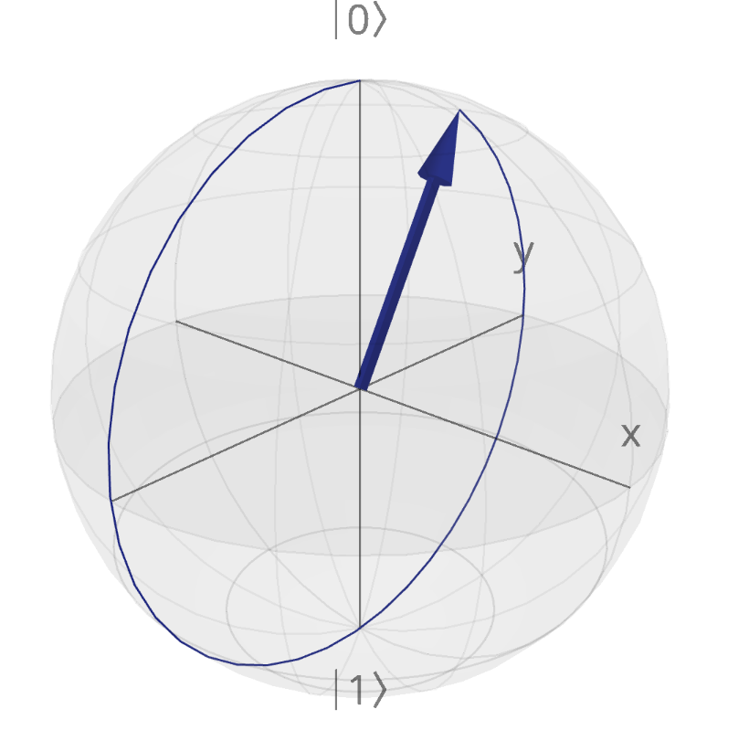
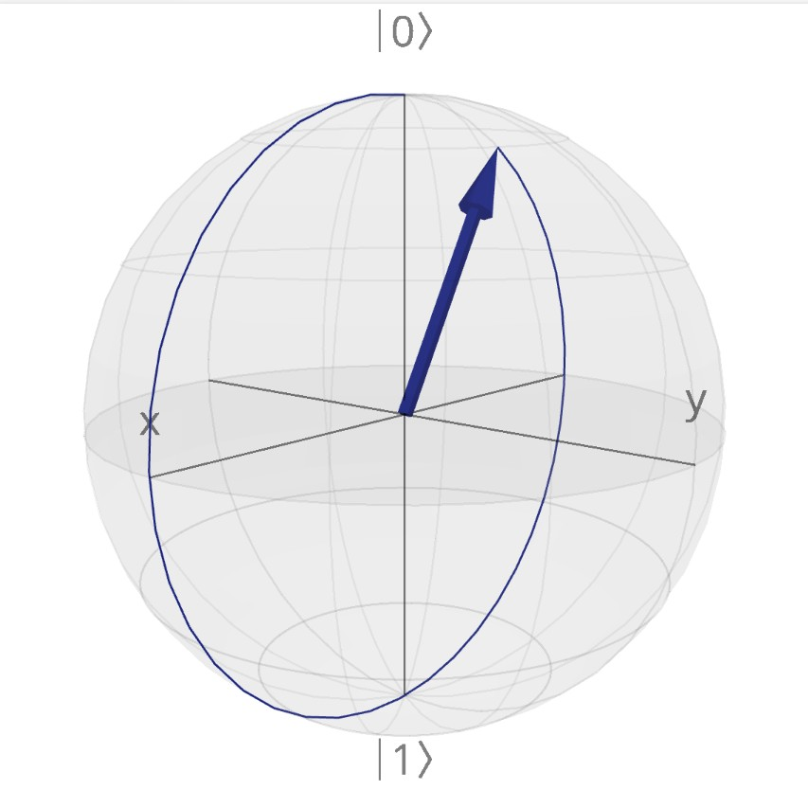


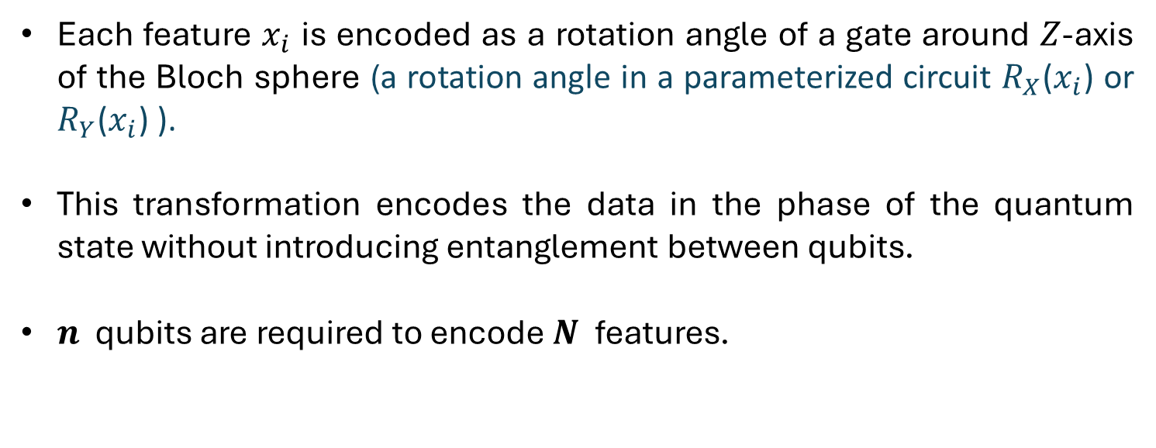
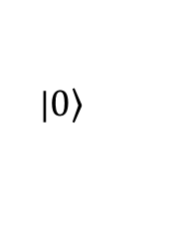

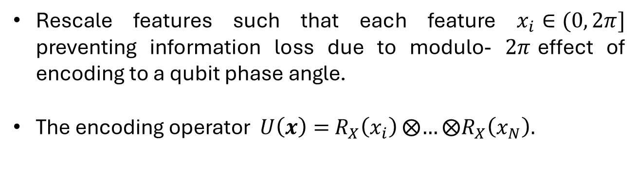
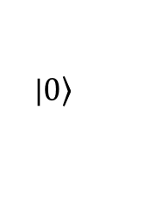

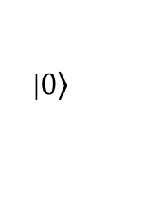


Angle Encoding
Each feature $x_{i}$​ is encoded as a rotation angle of a gate around $Z$-axis of the Bloch sphere (a rotation angle in a parameterized circuit $R_{X}$($x_{i}$) or $R_{Y}$($x_{i}$) ).
This transformation encodes the data in the phase of the quantum state without introducing entanglement between qubits.
$n$ qubits are required to encode $N$ features.
$$U(x)$$
|$\left.0\right\rangle$
$R_{X}$($x_{1}$)
Rescale features such that each feature $x_{i}∈(0, 2π]$ preventing information loss due to modulo- $2π$effect of encoding to a qubit phase angle.
The encoding operator $U\left(x\right)=$ $R_{X}\left(x_{i}\right)⨂{…}⨂R_{X}\left(x_{N}\right).$
|$\left.0\right\rangle$
$R_{X}$($x_{2}$)
$$⋮$$
$$⋮$$
|$\left.0\right\rangle$
$R_{X}$($x_{N}$)
Prepared by Dr. Marwa , Nile University

Slide 22
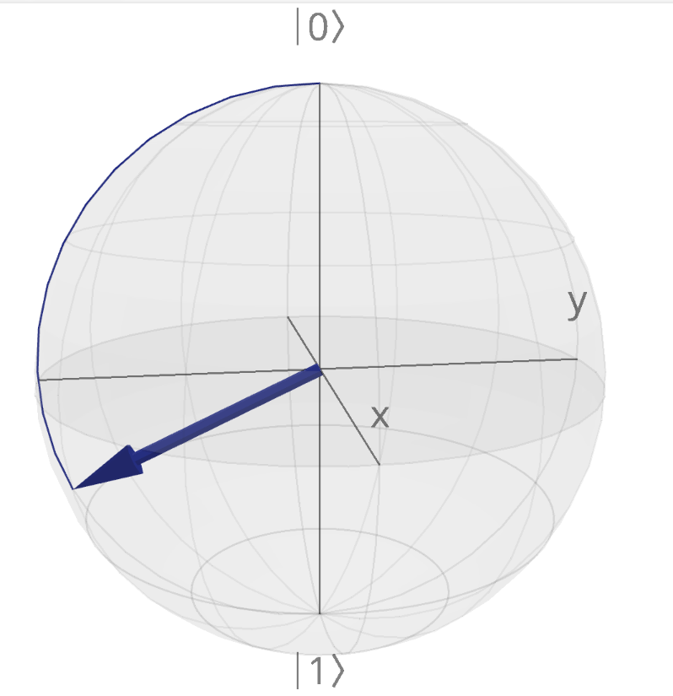
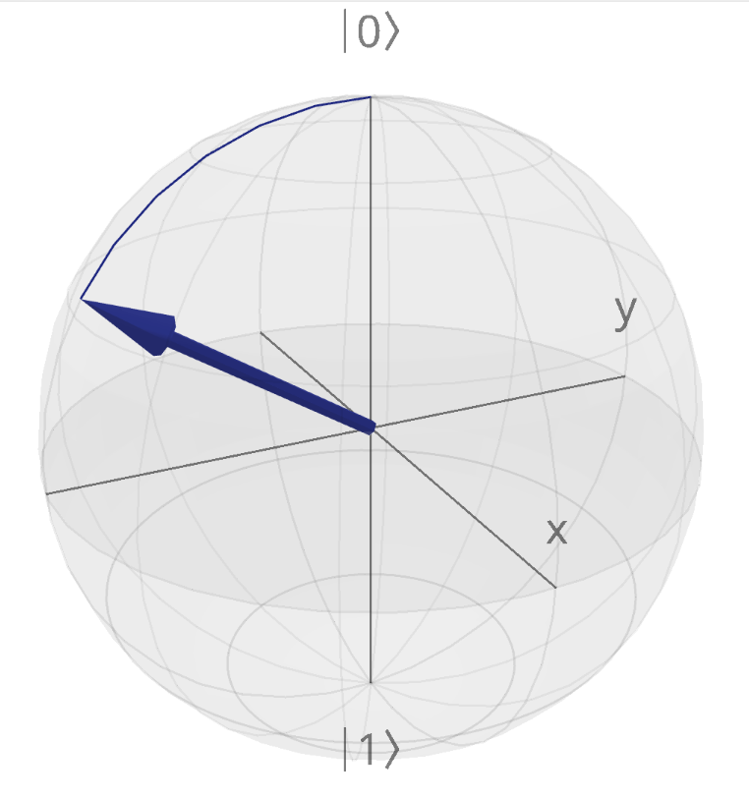
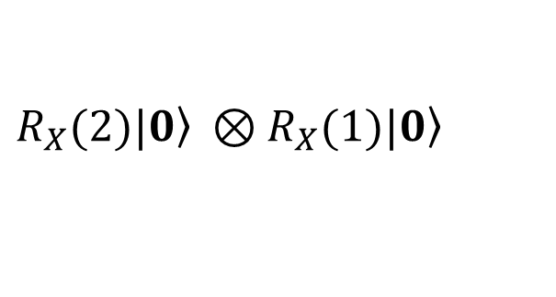

Angle Encoding
Example
$$\left(2,1 \right)$$
$R_{X}(2)|\left.0\right\rangle ⊗$ $R_{X}(1)|\left.0\right\rangle$
$$⊗$$
Prepared by Dr. Marwa , Nile University

Slide 23
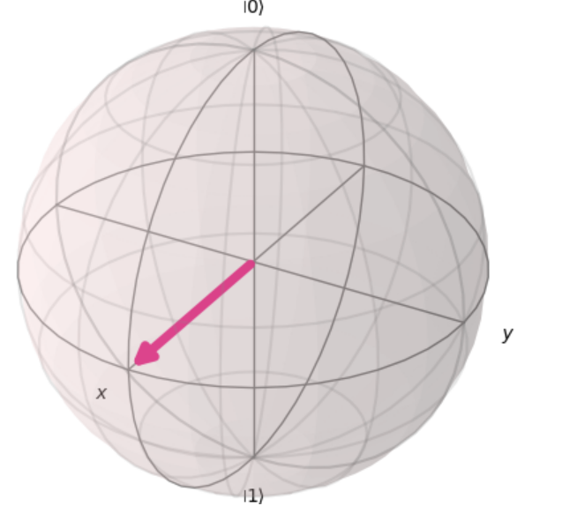



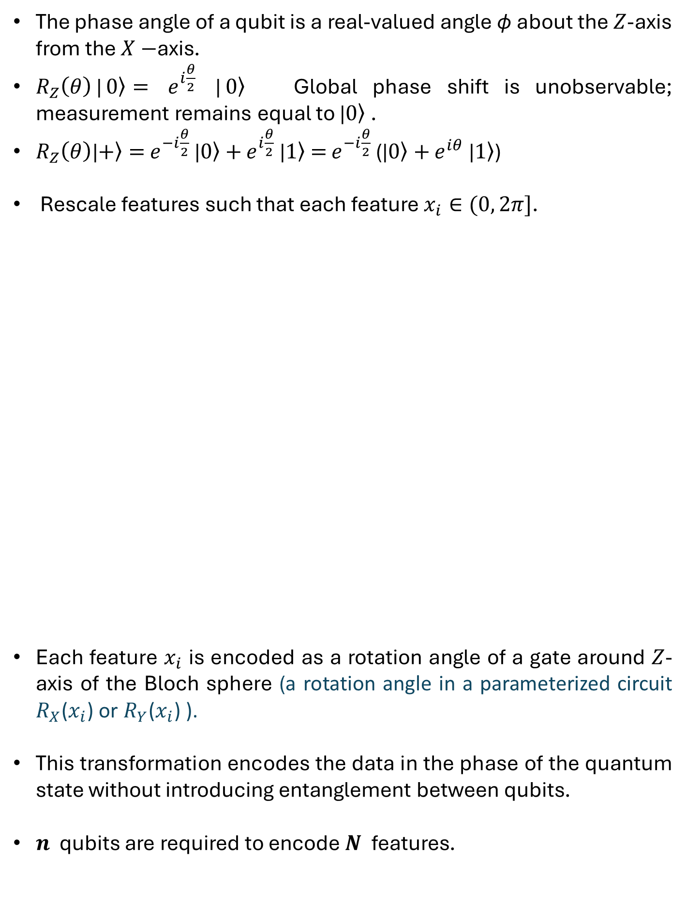





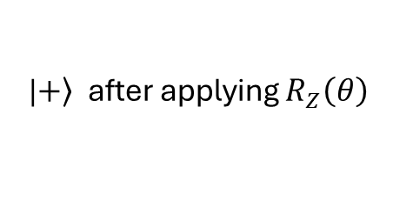


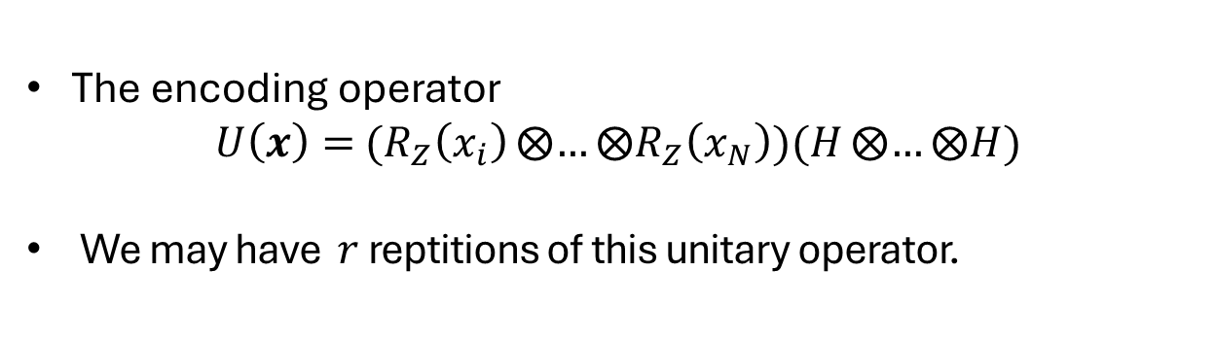


Phase Encoding (Z Feature Map)
The phase angle of a qubit is a real-valued angle ϕ about the$Z$-axis from the $X−$axis.
$R_{Z}\left(θ\right)$|$\left.0\right\rangle =$ $e^{i\frac{θ}{2}}$ |$\left.0\right\rangle$ Global phase shift is unobservable; measurement remains equal to |$\left.0\right\rangle$ .
$R_{Z}\left(θ\right)$|$\left.+\right\rangle =$ $e^{−i\frac{θ}{2}}$ |$\left.0\right\rangle$ $+$ $e^{i\frac{θ}{2}}$ |$\left.1\right\rangle$ $=$ $e^{−i\frac{θ}{2}}$ (|$\left.0\right\rangle$ $+$ $e^{iθ}$ |$\left.1\right\rangle$)
Rescale features such that each feature $x_{i}∈(0, 2π]$.
Each feature $x_{i}$​ is encoded as a rotation angle of a gate around $Z$-axis of the Bloch sphere (a rotation angle in a parameterized circuit $R_{X}$($x_{i}$) or $R_{Y}$($x_{i}$) ).
This transformation encodes the data in the phase of the quantum state without introducing entanglement between qubits.
$n$ qubits are required to encode $N$ features.
|$\left.+\right\rangle$ after applying $R_{Z}\left(θ\right)$
$$U(x)$$
The encoding operator
$U\left(x\right)=$ ${(R}_{Z}\left(x_{i}\right)⨂{…}⨂R_{Z}\left(x_{N}\right))(H⨂{…}⨂H)$
We may have $r$ reptitions of this unitary operator.
|$\left.0\right\rangle$
$$H$$
$R_{Z}$($x_{1}$)
|$\left.0\right\rangle$
$$H$$
$R_{Z}$($x_{2}$)
$$⋮$$
$$⋮$$
|$\left.0\right\rangle$
$$H$$
$R_{Z}$($x_{N}$)
Prepared by Dr. Marwa , Nile University

Slide 24
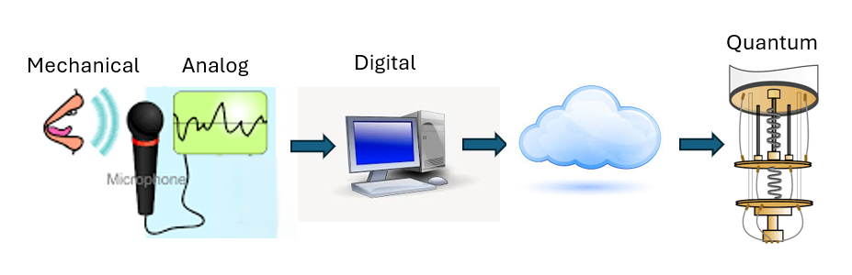

4. Representation of an Audio Signal on A Quantum Computer

Slide 25
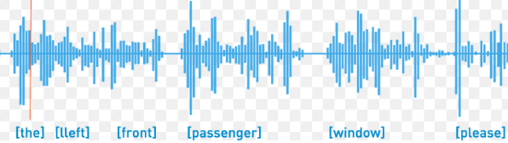
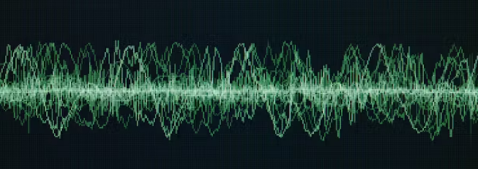
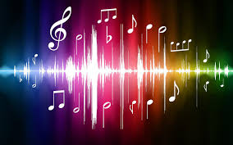
4. Representation of an Audio Signal on A Quantum Computer
It can include:
Speech / Voice Signals
General Sound/Audio Signals
Music Signal

Slide 26
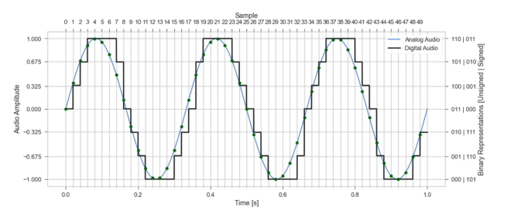
4. Representation of an Audio Signal on A Quantum Computer
Binary representation of the signal
Sound is a one-dimensional (1D) signal in the time domain
Audio Amplitude
Samples
Time (t)
Fig. 1

Slide 27
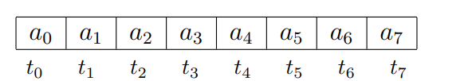
4. Representation of an Audio Signal on A Quantum Computer
After being digitized, the audio’s binary information is stored in an array vector.
variable
index
Audio Array Visualization

Slide 28
4. Representation of an Audio Signal on A Quantum Computer
Dirac’s notation clearly shows how the audio information (time and amplitude) can be translated into quantum states.
We shall explore how these representations of quantum audio are prepared and measured, as well as potential near-term and long-term applications

Slide 29
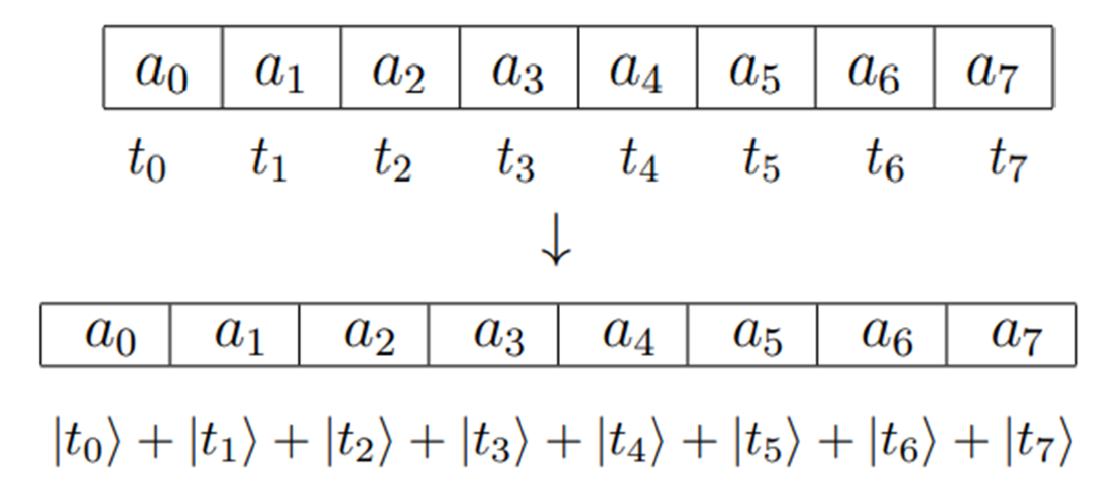
4. Representation of an Audio Signal on A Quantum Computer
How the audio information (time and amplitude) can be translated into quantum states.
Classical
Quantum
Fig. 2

Slide 30
Flexible Representation Quantum Audio (FRQA)
4. Representation of an Audio Signal on A Quantum Computer State-Oriented Representations
F. Yan et al. [2] presented the Flexible Representation Quantum Audio (FRQA).
The paper presented how to realize the quantum circuits to accomplish basic audio signals ( addition, inversion, and delay)
These operations can be employed to build advanced applications for particular quantum computing applications.

Slide 31

Flexible Representation Quantum Audio (FRQA)
4. Representation of an Audio Signal on A Quantum Computer
FRQA encodes the amplitude values in quantum audio in a bipolar (both non-negative and negative) manner, i.e.
(6)
The most widespread method to represent bipolar numbers is based on using two’s complement notation.

Slide 32

Flexible Representation Quantum Audio (FRQA)
4. Representation of an Audio Signal on A Quantum Computer
Hence, the extension to encode the amplitude value in quantum audio using the two’s complement arithmetic is shown in Eq. 7 below:
(7)
where t = 0, 1, . . . , 2 ^{l − 1} denotes the time information of a 2 ^{l} -sized quantum audio signal,
is the binary sequence encoding the two’s complement notation of the amplitude value.

Slide 33
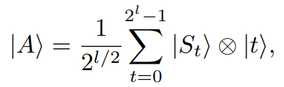
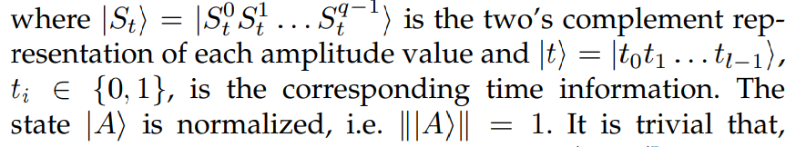
Flexible Representation Quantum Audio (FRQA)
Therefore, the quantum representative expression of a 2 ^{l} -sized FRQA audio can be written as below:
(8)
the FRQA needs (q + l) qubits to represent a quantum audio with 2 ^{l} samples.

Slide 34
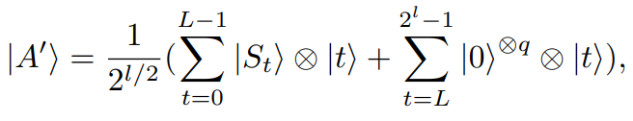
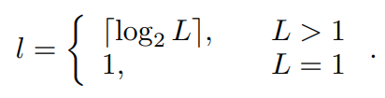
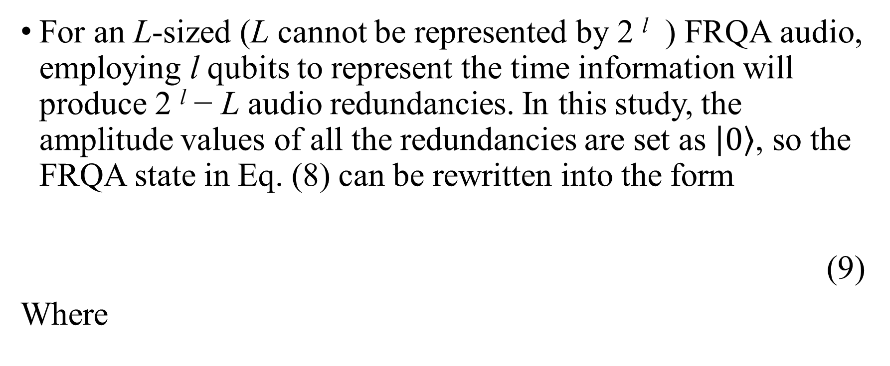
Flexible Representation Quantum Audio (FRQA)
For an L-sized (L cannot be represented by 2 ^{l} ) FRQA audio, employing l qubits to represent the time information will produce 2 ^{l} − L audio redundancies. In this study, the amplitude values of all the redundancies are set as $\left|\left.0\right\rangle \right.$, so the FRQA state in Eq. (8) can be rewritten into the form
(9)
Where

Slide 35
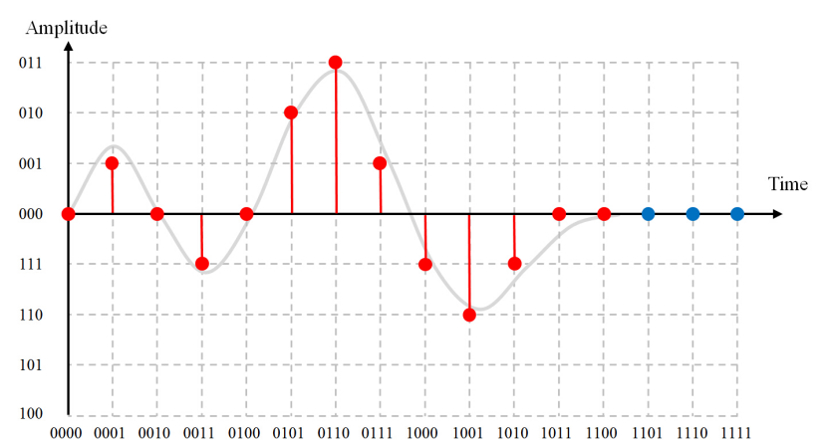
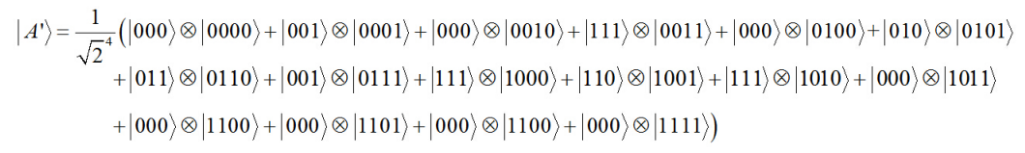
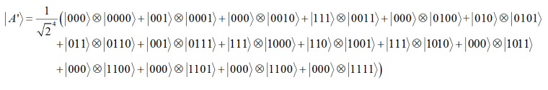
Flexible Representation Quantum Audio (FRQA)
q = 3
l = 4
Amplitude
A segment of an FRQA audio signal and its representation (blue points are the redundancies) [3].
Time
Fig. 3

Slide 36
Flexible Representation Quantum Audio (FRQA)
where q is the length of the binary sequence used to store each number, at (t = 0, 1, . . . , L-1) denotes the t th amplitude value in an L-sized Audio audio.
q = 3
l = 4

Slide 37
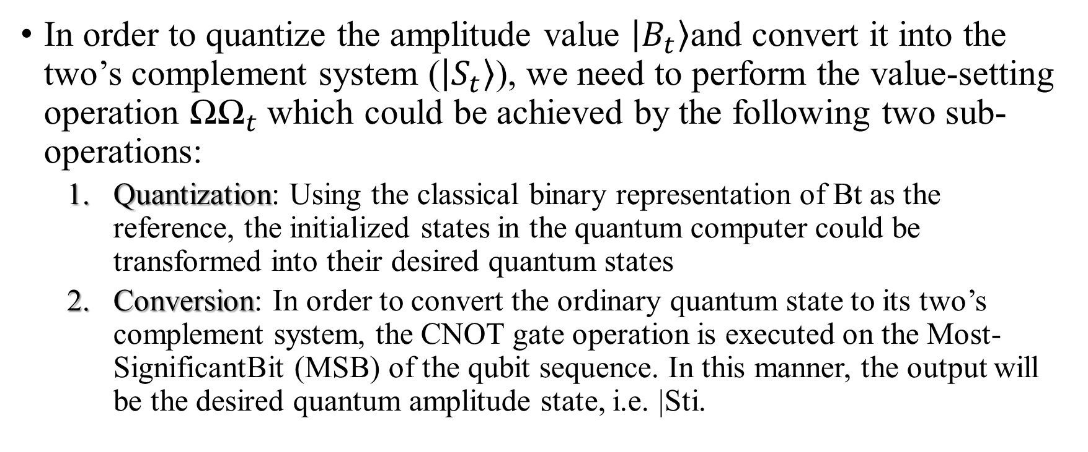
FRQA Preparation
In order to quantize the amplitude value $\left|\left.B_{t}\right\rangle \right.$and convert it into the two’s complement system ($\left|\left.S_{t}\right\rangle \right.$), we need to perform the value-setting operation ${\text{ΩΩ}}_{t}$which could be achieved by the following two sub-operations:
Quantization: Using the classical binary representation of Bt as the reference, the initialized states in the quantum computer could be transformed into their desired quantum states
Conversion: In order to convert the ordinary quantum state to its two’s complement system, the CNOT gate operation is executed on the Most-SignificantBit (MSB) of the qubit sequence. In this manner, the output will be the desired quantum amplitude state, i.e. |Sti.

Slide 38



7. FRQA Preparation
Fig.4 Decomposition of some complicated quantum gates.

Slide 39

7. FRQA Preparation
Fig.5 Network of implementing the operation when preparing the sample at 5

Slide 40


Image and Audio Similarities and Possibilities in QML
f(t)
1. Data Representation
Audio data is inherently temporal, meaning it unfolds over time.
This requires models that can handle sequential data, unlike static image data.
time
f(x,y)

Slide 41


Image and Audio Similarities and Differences in QML
2. Feature Extraction
Quantum models need to be tailored to capture these nuances.
Audio features are more complex, involving frequency, amplitude, and temporal patterns
Images have spatial features (e.g., edges, textures),
Audio Formant frequencies
Thomas.haslwanter
Creative Commons Attribution-Share Alike 4.0
Image Features: and example of edge detecion

Slide 42
Image and Audio Similarities and Differences in QML
Combining these can make it harder to achieve accurate results.
Audio signals can be noisy, and quantum systems are also prone to noise.
3. Quantum Noise Sensitivity

Slide 43
Image and Audio Similarities and Differences in QML
Large, labeled datasets are crucial for training machine learning models. While image datasets are abundant, high-quality audio datasets for specific tasks may be harder to find.
4. Dataset Availability

Slide 44
Image and Audio Similarities and Differences in QML
Audio recognition often requires recurrent architectures to capture temporal dependencies. Adapting these to quantum systems is still an area of active research.
5. Model Complexity

Slide 45
Machine learning Methods
- Linear Models
- Neural Networks
- Graphical Methods
- Kernel Methods)

Slide 46

The Biological Neural Network
Attribution-NonCommercial-NoDerivs 3.0 Unported

Slide 47




The Artificial Neural Network vs the Biological Neural Network
Input: x ={x_{1,} x_{2. …} x_{n} }
Trainable Parameters:
$$W=\text{\{}\text{w}\text{1}\text{, }\text{w}\text{2}\text{. }\text{… }\text{w}\text{n} \text{\}}$$
$$b=\text{\{}\text{b}\text{1}\text{, }\text{b}\text{2}\text{. }\text{… }\text{b}\text{n} \text{\}}$$
https://commons.wikimedia.org/wiki/File:Example_of_a_neural_network%27s_neural_unit.png

Slide 48






We want $y≈\hat{y}$
Trainable Parameters:
Input: x ={x_{1,} x_{2. …} x_{n} }
Target valuey y ={y_{1,} y_{2. …} y_{n} }
Predicted value:
$$θ=\left\{W,b\right\}$$
$$W=\text{\{}\text{w}\text{1}\text{, }\text{w}\text{2}\text{. }\text{… }\text{w}\text{n} \text{\}}$$
$$b=\text{\{}\text{b}\text{1}\text{, }\text{b}\text{2}\text{. }\text{… }\text{b}\text{n} \text{\}}$$

Slide 49

Quantum Neural Network

Slide 50

Quantum Neural Network

Slide 51


Quantum Neural Networks (QNNs)

Slide 52

Quantum Neural Networks (QNNs)

Slide 53

Thank you! Questions?
The future belongs to those who believe in the beauty of their dreams.
Eleanor Roosevelt

Slide 54
References
[1] M. Cerezo, G. Verdon, H. Y. Huang, L. Cincio, and P. J. Coles, “Challenges and opportunities in quantum machine learning,” Nat Comput Sci, vol. 2, no. 9, pp. 567–576, Sep. 2022, doi: 10.1038/s43588-022-00311-3.
[2] E. Perrier, A. Youssry, and C. Ferrie, “QDataset: Quantum Datasets for Machine Learning,” Aug. 2021, [Online]. Available: http://arxiv.org/abs/2108.06661
[3] F. Yan, A. M. Iliyasu, Y. Guo, and H. Yang, “Flexible representation and manipulation of audio signals on quantum computers,” Theor Comput Sci, vol. 752, pp. 71–85, Dec. 2018.
[4] E. R. Miranda, Quantum Representations of Sound: from mechanical waves to quantum circuits. Springer International Publishing, 2022. doi: 10.1007/978-3-031-13909-3
[3] M. Schuld and F. Petruccione, “Supervised Learning with Quantum Computers.” doi: https://doi.org/10.1007/978-3-319-96424-9.
[4] M. Schuld and N. Killoran, “Quantum machine learning in feature Hilbert spaces,” Mar. 2018, doi: 10.1103/PhysRevLett.122.040504.

